Slide 1


ArcGIS API for JavaScript: Web Editing in 2D
Jose Banuelos
Heather Gonzago
2022 ESRI DEVELOPER SUMMIT
Notes:
2022 Esri Developer Summit

Slide 2

Thank you for joining us. Please feel free to ask questions throughout the session here. We will answer live and Sli.do questions during our Q&A. If we’re unable to answer your question, we’ll do our best to answer them in Sli.do during the conference or follow up directly if you provide your name. If you will be sharing a list of questions and answers elsewhere, too, please note that at this time.

Slide 3

Agenda
Topics covered in this presentation
Web editing
What is it and how does it work?
Editing widgets
Editor
FeatureForm
FeatureTemplates
Sketch/SketchViewModel
etc.
Form work
Sketching/editing

Slide 4
Enable editing on a feature service
The feature service must be enabled for editing
Constraints are set at the service level
Client apps, i.e. the JavaScript API, cannot override any permissions set on the service
Client API accesses REST API calls

Slide 5
JavaScript API editing basics
Granular API
Using ApplyEdits directly off the FeatureLayer
Configurable widgets
Encapsulates granular functionality
Easy to use as-is
Configurable
Two parts, view UI (ie. widget), and its underlying logic (ie. viewModel)

Slide 6
Configurable widgets
FeatureTable
FeatureForm
FeatureTemplates
SketchViewModel
Editor
New at 4.23
SnappingControls
Attachments

Slide 7
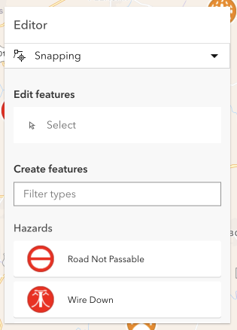
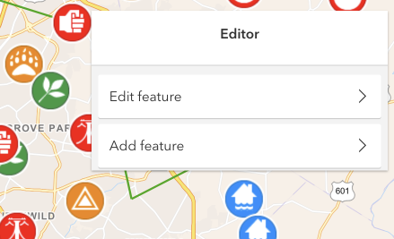
4.23 Editor had a make over
Editor refactored at 4.23
One initial panel that consolidates both the create and update workflows.
Continuous (batch) editing for create workflow
Integrated snapping controls UI
Additional Editor updates expected in future releases

Slide 8

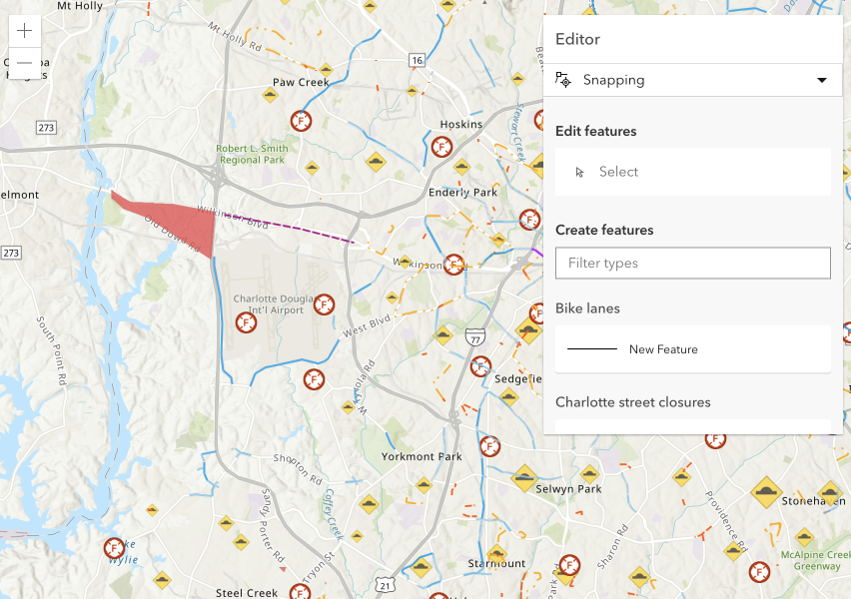
Editor
Widget used as-is (ie. no configuration)

Slide 9

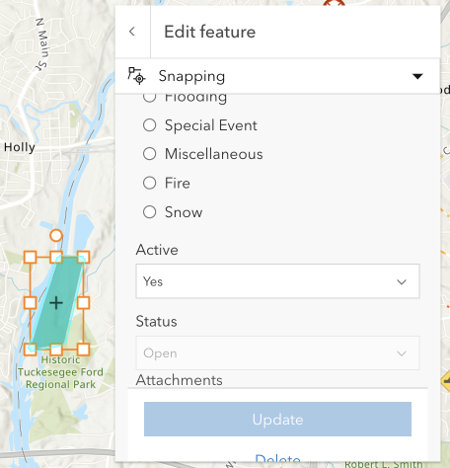
Granular control for editing
LayerInfos for layer-specific editing permissions
FormTemplate provides granular control
Field type
Grouped or ungrouped
Descriptive text
Hint
Description
Input types
Field expressions

Slide 10
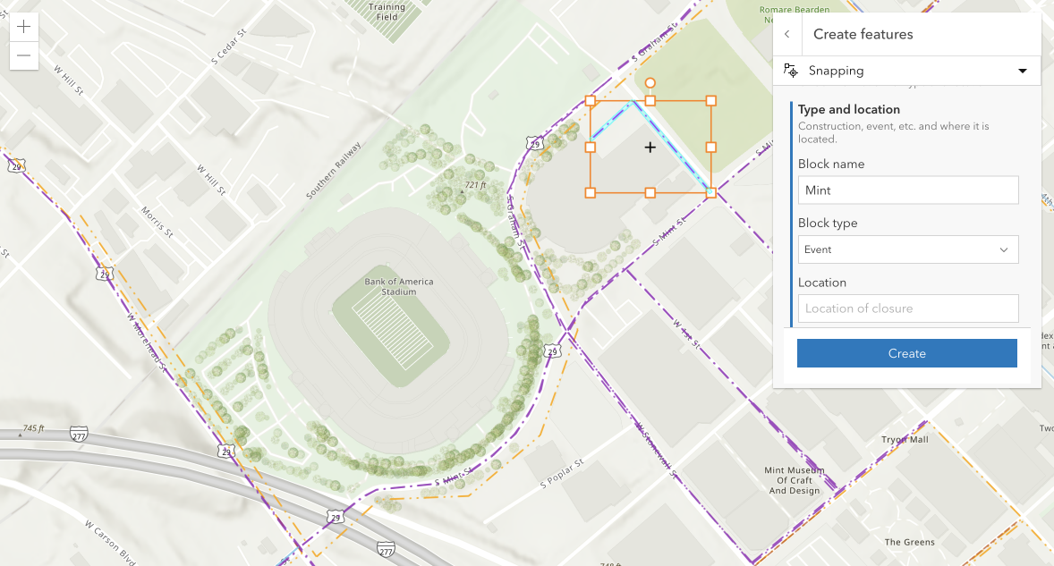
Editor
Configured

Slide 11
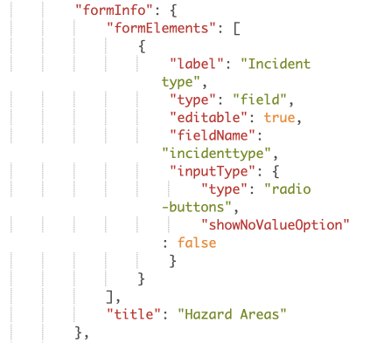
Webmap forms
FormInfo is saved within the webmap
Author form content online
Consume form’s info without a lot of code

Slide 12
Editor
WebMap form updates

Slide 13
Contingent Values Support
Jose Banuelos

Slide 14
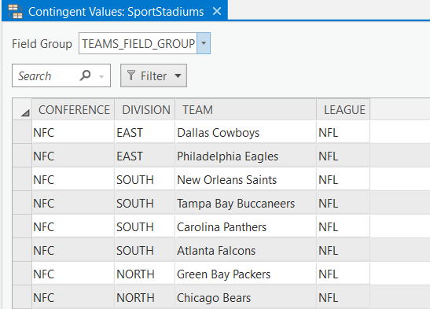
Contingent Values
Contingent values are a data design feature that restricts the valid values in one field based off the field value in another
Values in one field are dependent on another
Help preserve data integrity
A field group defines the fields that make up the contingency

Slide 15
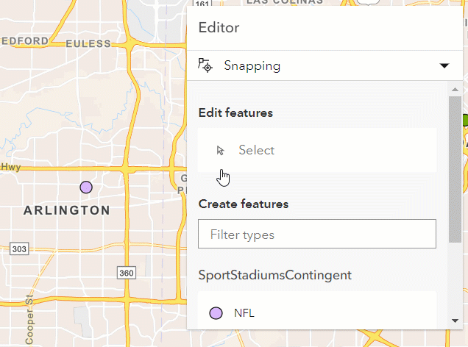
Contingent Values in the JavaScript API
FeatureForm and Editor support
Support for multiple field groups
Restrictive

Slide 16
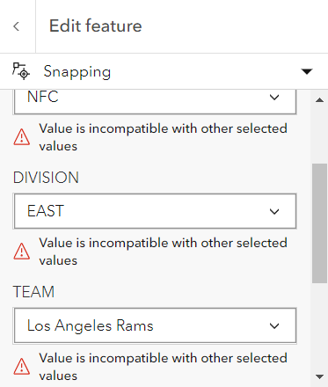
Contingent Values Validation
All validation is done on the client
If a value is invalid for a contingency, then there will be an error that displays on all the fields that make up that field group

Slide 17
Sketch
Jose Banuelos

Slide 18
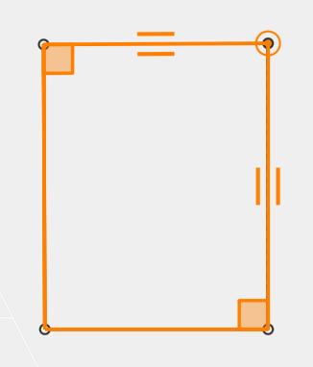
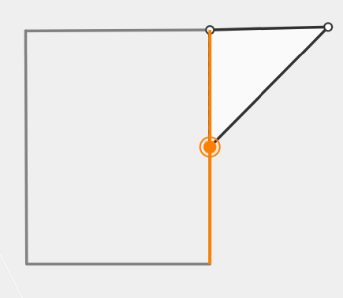
Snapping (self and feature)
Self snapping (geometry guides)
Feature snapping

Slide 19
Snapping (continued…)
FeatureSnappingLayerSource
The layers we want to snap to with feature snapping
Layer type support
FeatureLayer
GraphicsLayer
CSVLayer
GeoJSONLayer
WFSLayer

Slide 20
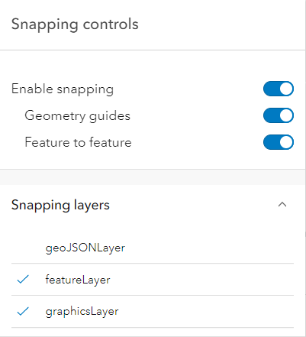
Snapping (continued…)
SnappingOptions
Class used to configure snapping for editing and drawing workflows
Editor, Sketch, SketchViewModel, SnappingControls
SnappingControls
Widget created to handle SnappingOptions props via a user interface
Embedded in Editor and Sketch

Slide 21
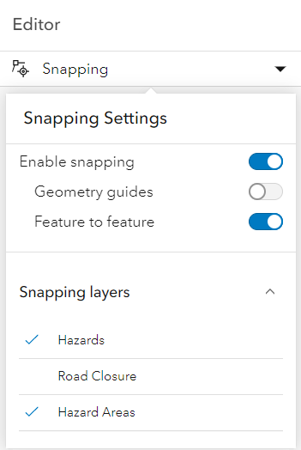
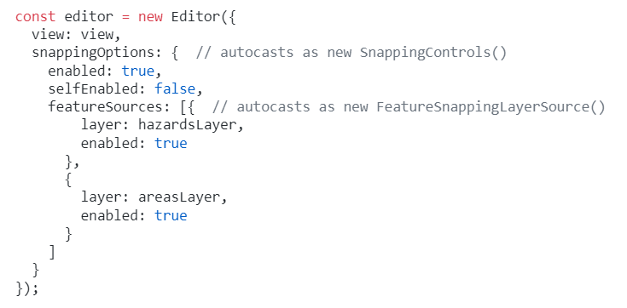
Snapping (Let us show some code)
SnappingOptions
enabled
selfEnabled
featureEnabled
featureSources

Slide 22
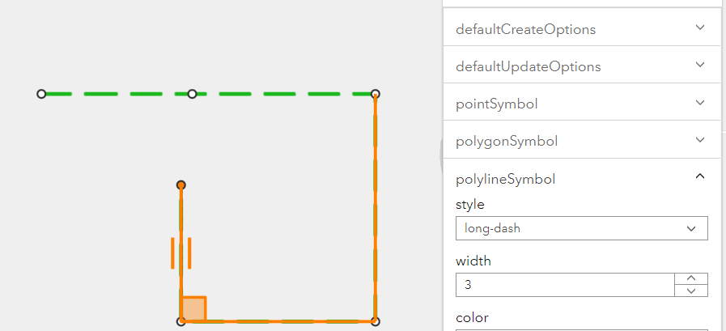
Snapping with SketchViewModel and SnappingControls
Live Demo

Slide 23
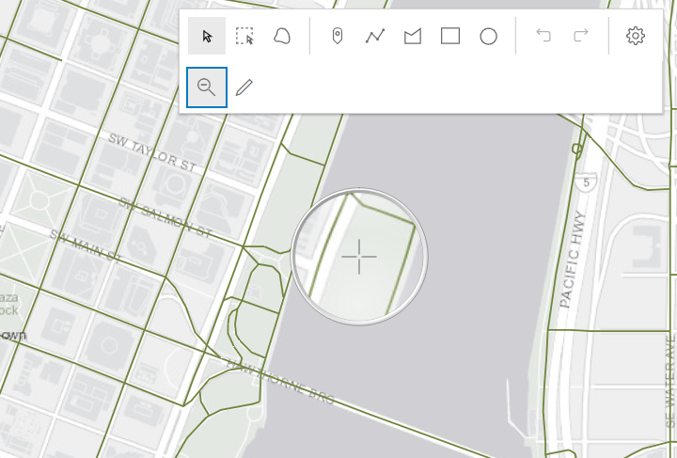
Custom Sketch tools
Live Demo

Slide 24
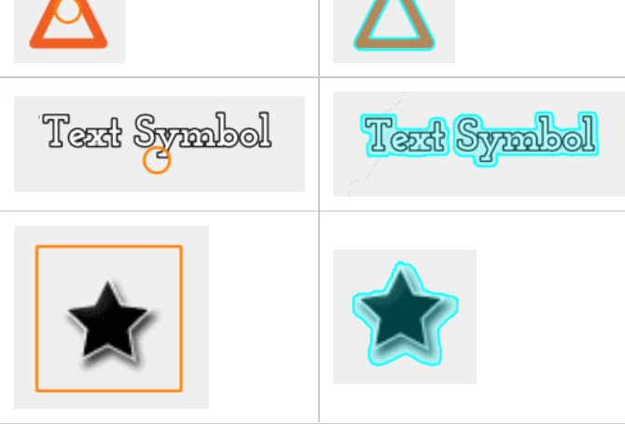
Sketch & Editor: Improvements to selection and highlight
HitTest improvements in the API led to an improved hitTest for SketchViewModel
CIMSymbol
PictureMarkerSymbol
TextSymbol
Improved highlight around these symbols
Control highlight with MapView.highlightOptions
Affects Sketch & Editor

Slide 25
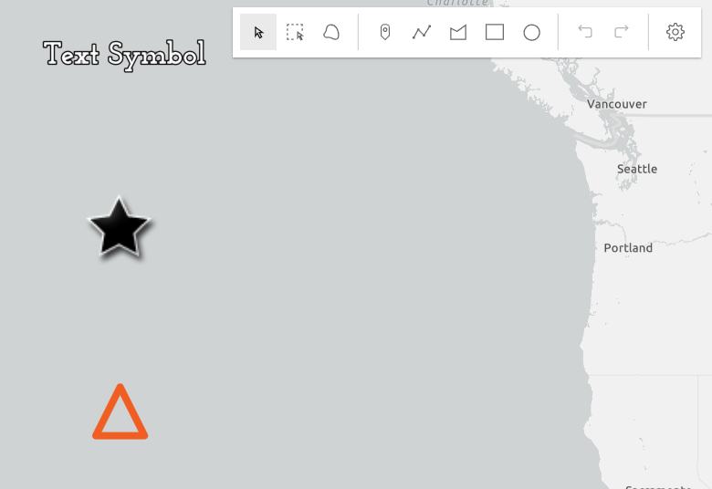
Selection & Highlight
Live Demo

Slide 26
Questions?

Slide 27




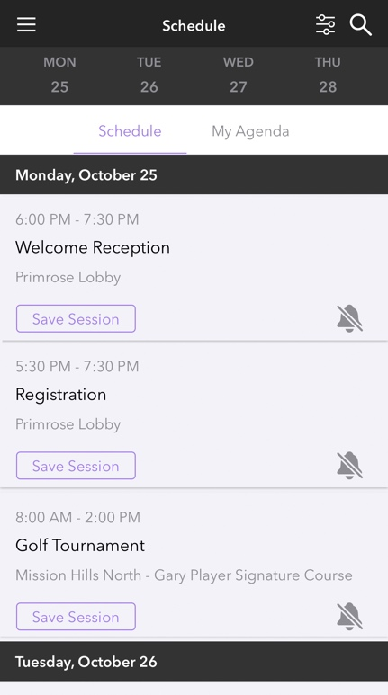

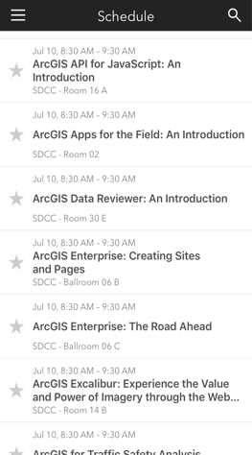
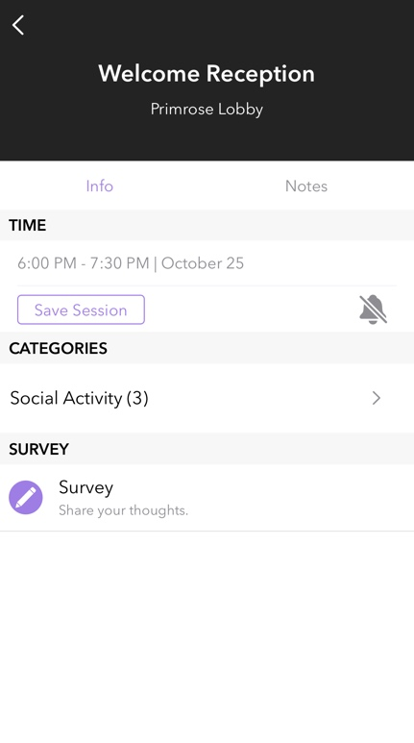

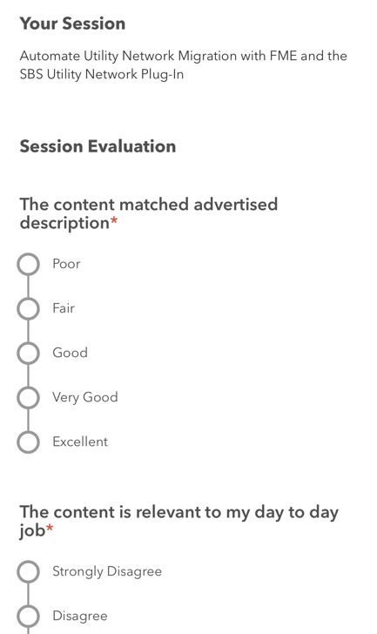
Please Share Your Feedback in the App
Download the Esri Events app and find your event
Select the session you attended
Scroll down to “Survey”
Log in to access the survey

Slide 28



Copyright © 2022 Esri. All rights reserved.

